Slide 1
MY TEACHING PRACTICUM II
INSTITUCIÓN EDUCATIVA INEM (LORENZO MARIA LLERAS).
GUILLERMO CARDONA ARANGO

Slide 2
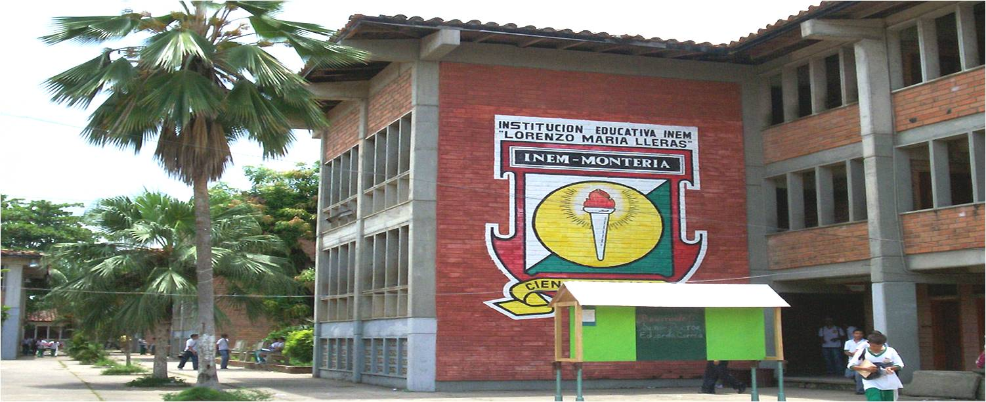

INEM
STATE HIGHS CHOOL
EIGHTH GRADE 8-1
NUMBER OF STUDENTS: 35

Slide 3
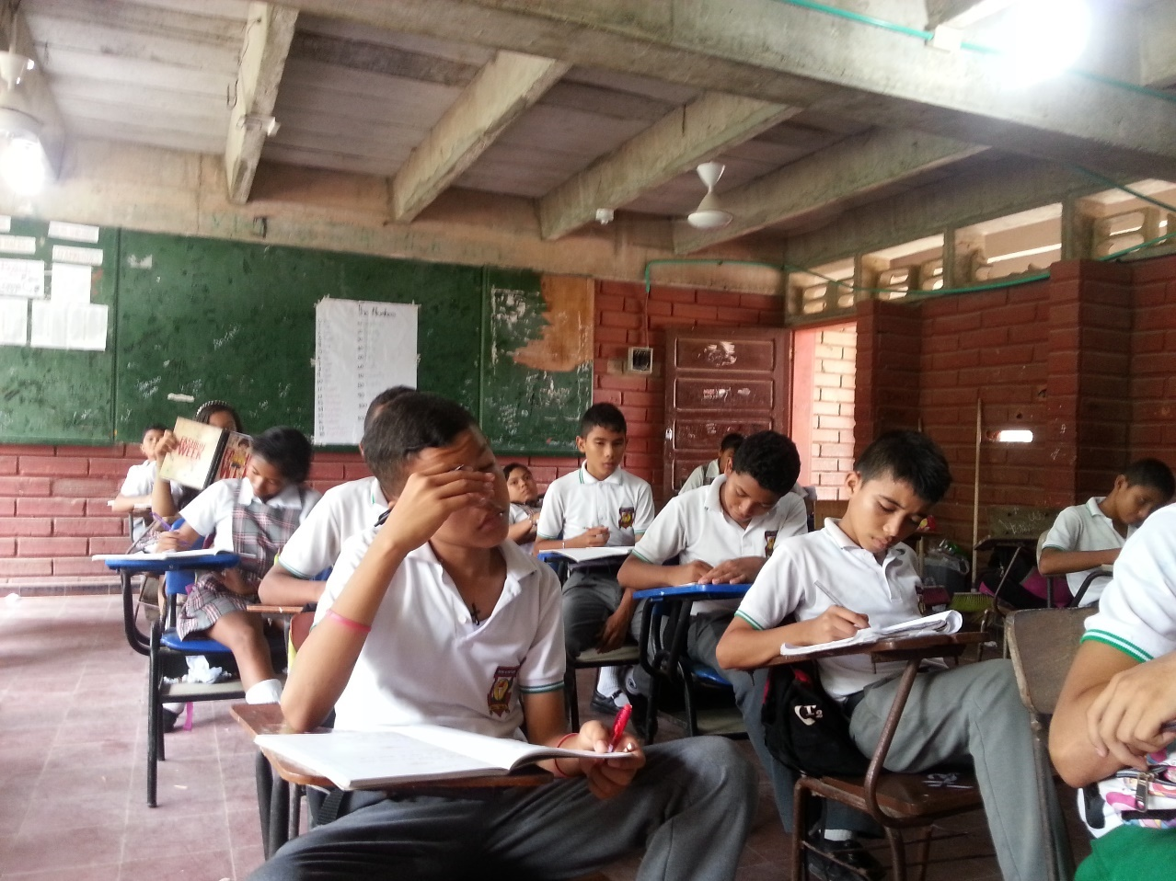
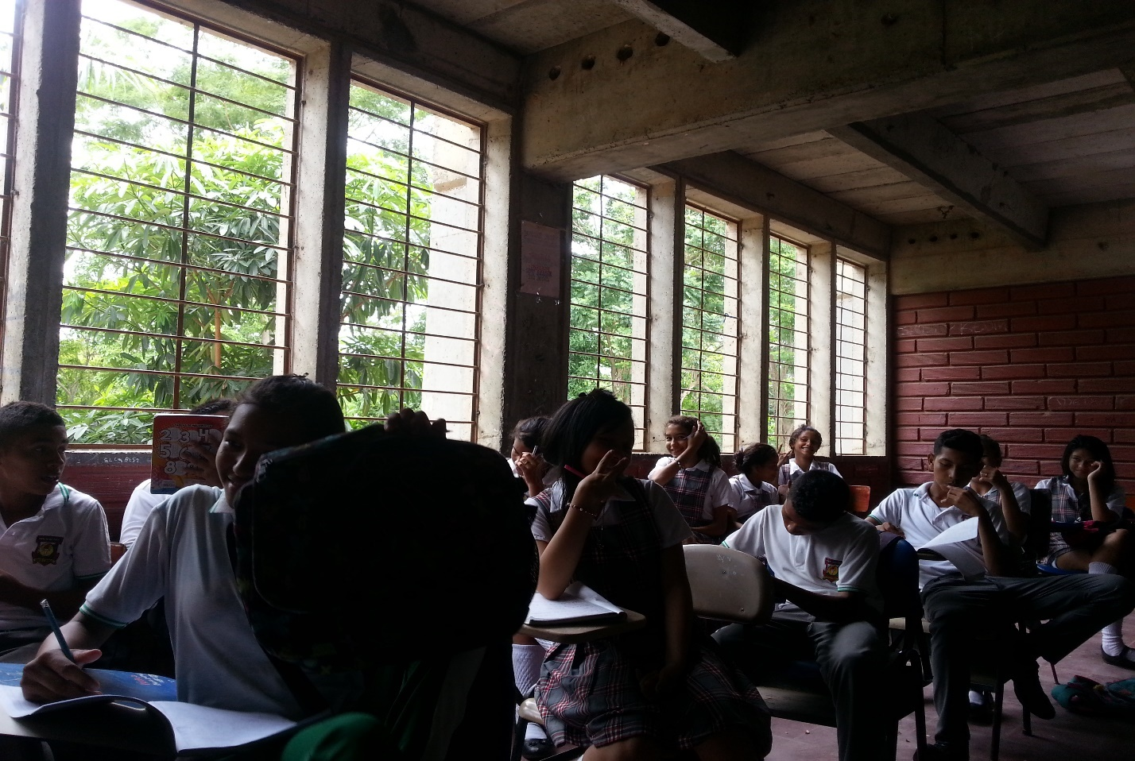
MY STUDENTS

Slide 4

STRATEGIES
DELIVERING INSTRUCTION
ENGAGING STUDENTS
REACHING STRUGGLING STUDENTS

Slide 5
RESULTS
Students really enjoyed my classes.
Students trust me, they told me about their problems, dreams and what they want to be in the future.
Classes were conducted in the way I expected.
Students with bad behavior participated in the activities.

Slide 6
DIFFICULTIES
I did not know how to give the instructions in a clear way.
I had problems with the classroom management.
My handwriting was not readable.
MOST STUDENTS WERE AFRAID TO SPEAK IN THE CLASSROOM.

Slide 7
REFLECTION
Give the instructions in a clear way.
Be careful at the moment to give them feedback.
Do not forget give positive feedback to those students that participate in the activities.
You need to know the context in which your students live .
Do not be just their teacher be also their friend.

Slide 8
THIS EXPERIENCE WAS...

Slide 9
INSTRUCTIONAL-AS A TEACHER
I learnt to deal with problems that can suddenly occur in the classroom.
You have to forget your personal problems when you are inside the classroom.
Avoid teach just content, your classes have to be interesting, with materials and variety of activities.
You always have to look for information about strategies and methodologies that can help you in the teaching process.

Slide 10

INCENTIVE-AS A PERSON
The most important thing is that at list they learn something about your class before let the classroom.
I learnt to love my job, put aside the mediocrity and do my best.
Share time with your students will become gratifying when you know them.

Slide 11


Slide 12


